Slide 1
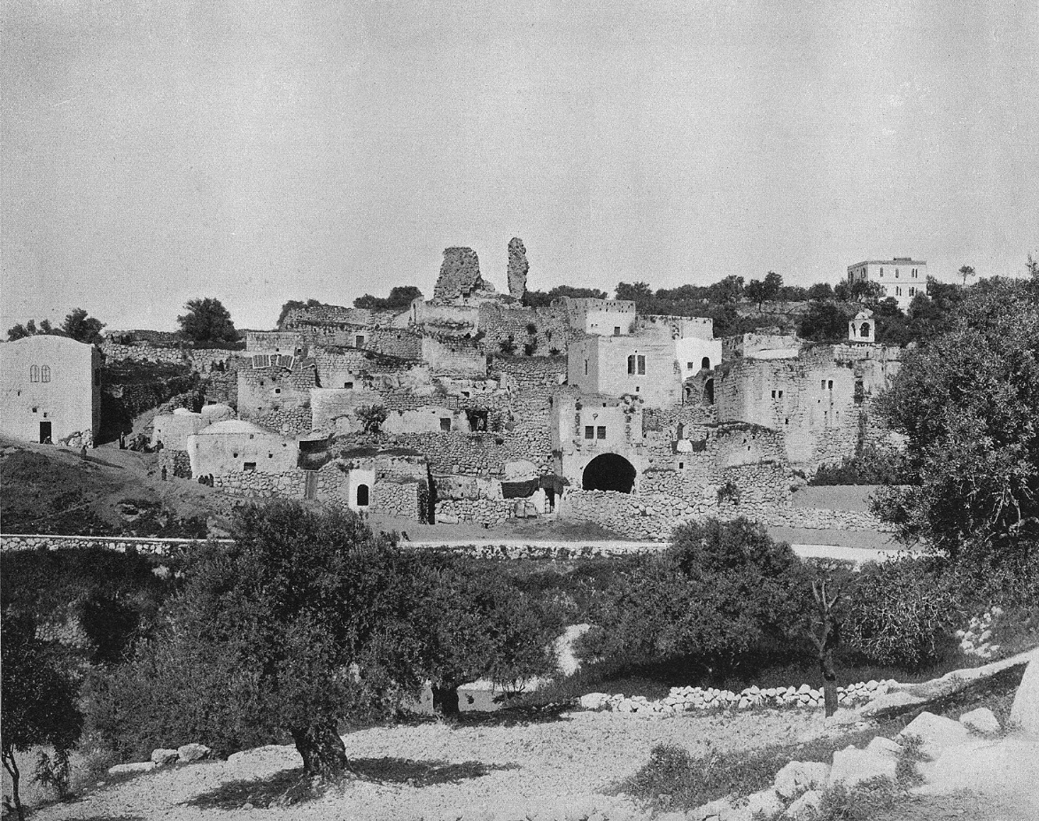
John 11.1-46
Village of Bethany in 1890s
from Earthly Footsteps of the Man of Galilee / © 2003 Todd Bolen

Slide 2
John 11.1-2 NASB: Now a certain man was sick, Lazarus of Bethany, the village of Mary and her sister Martha. It was the Mary who anointed the Lord with ointment, and wiped His feet with her hair, whose brother Lazarus was sick.

Slide 3
John 11.3-6: So the sisters sent word to Him, saying, “Lord, behold, he whom You love is sick.” But when Jesus heard this, He said, “This sickness is not to end in death, but for the glory of God, so that the Son of God may be glorified by it.” Now Jesus loved Martha and her sister and Lazarus. So when He heard that he was sick, He then stayed two days longer in the place where He was.

Slide 4
John 11.3-6: So the sisters sent word to Him, saying, “Lord, behold, he whom You love is sick.” But when Jesus heard this, He said, “This sickness is not to end in death, but for the glory of God, so that the Son of God may be glorified by it.” Now Jesus loved Martha and her sister and Lazarus. So when He heard that he was sick, He then stayed two days longer in the place where He was.
κύριος [KOO-ree-oss] = “Sir” or “Lord” or “Master”

Slide 5
John 11.3-6: So the sisters sent word to Him, saying, “Lord, behold, he whom You love is sick.” But when Jesus heard this, He said, “This sickness is not to end in death, but for the glory of God, so that the Son of God may be glorified by it.” Now Jesus loved Martha and her sister and Lazarus. So when He heard that he was sick, He then stayed two days longer in the place where He was.

Slide 6
John 11.3-6: So the sisters sent word to Him, saying, “Lord, behold, he whom You love is sick.” But when Jesus heard this, He said, “This sickness is not to end in death, but for the glory of God, so that the Son of God may be glorified by it.” Now Jesus loved Martha and her sister and Lazarus. So when He heard that he was sick, He then stayed two days longer in the place where He was.
οὖν [OON] = therefore,
consequently, so
δέ [DEH] = new topic related to previous one

Slide 7
John 11.7-8: Then after this He said to the disciples, “Let us go to Judea again.” The disciples said to Him, “Rabbi, the Jews were just now seeking to stone You, and are You going there again?”
Ἰουδαῖοι [ee-oo-DIE-oy] = Jews, Judeans,
or Jewish religious leaders

Slide 8
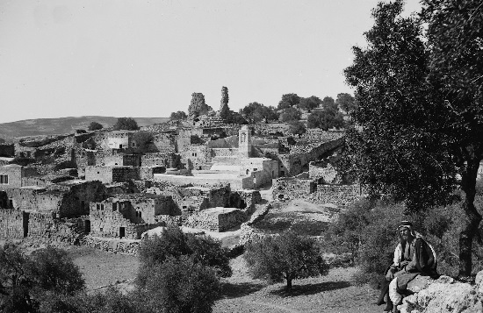
John 11.9-10: Jesus answered, “Are there not twelve hours in the day? If anyone walks in the day, he does not stumble, because he sees the light of this world. But if anyone walks in the night, he stumbles, because the light is not in him.”
Bethany in early 1900s / photo from G. Eric Matson collection
©2009 Todd Bolen / LifeintheHolyLand.com

Slide 9
John 11.11-16: This He said, and after that He said to them, “Our friend Lazarus has fallen asleep; but I go, so that I may awaken him out of sleep.” The disciples then said to Him, “Lord, if he has fallen asleep, he will recover.” Now Jesus had spoken of his death, but they thought that He was speaking of literal sleep. So Jesus then said to them plainly, “Lazarus is dead, and I am glad for your sakes that I was not there, so that you may believe; but let us go to him.” Therefore Thomas, who is called Didymus, said to his fellow disciples, “Let us also go, so that we may die with Him.”

Slide 10
John 11.11-16: This He said, and after that He said to them, “Our friend Lazarus has fallen asleep; but I go, so that I may awaken him out of sleep.” The disciples then said to Him, “Lord, if he has fallen asleep, he will recover.” Now Jesus had spoken of his death, but they thought that He was speaking of literal sleep. So Jesus then said to them plainly, “Lazarus is dead, and I am glad for your sakes that I was not there, so that you may believe; but let us go to him.” Therefore Thomas, who is called Didymus, said to his fellow disciples, “Let us also go, so that we may die with Him.”

Slide 11
John 11.11-16: This He said, and after that He said to them, “Our friend Lazarus has fallen asleep; but I go, so that I may awaken him out of sleep.” The disciples then said to Him, “Lord, if he has fallen asleep, he will recover.” Now Jesus had spoken of his death, but they thought that He was speaking of literal sleep. So Jesus then said to them plainly, “Lazarus is dead, and I am glad for your sakes that I was not there, so that you may believe; but let us go to him.” Therefore Thomas, who is called Didymus, said to his fellow disciples, “Let us also go, so that we may die with Him.”

Slide 12
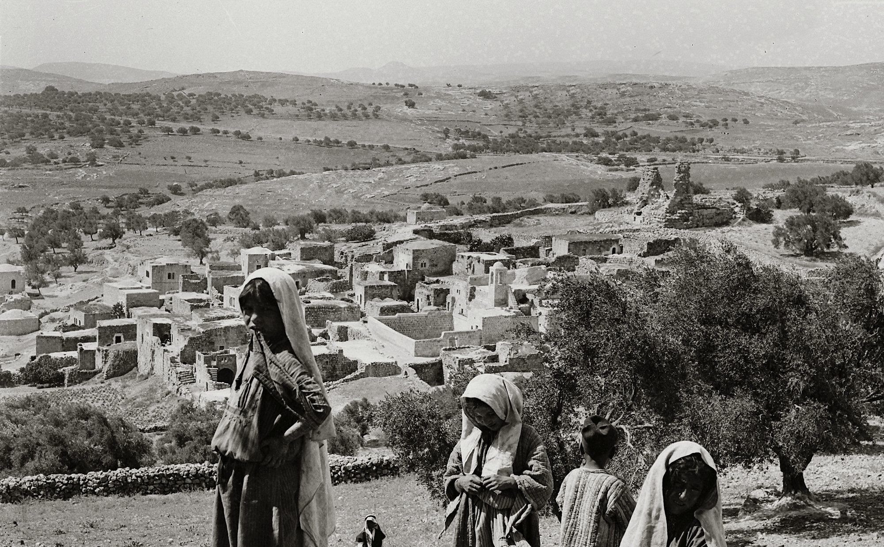
John 11.17-19: So when Jesus came, He found that he had already been in the tomb four days. Now Bethany was near Jerusalem, about two miles off; and many of the Jews had come to Martha and Mary, to console them concerning their brother.
Bethany from Mount of Olives in early 1900s
G. Eric Matson collection / ©2009 Todd Bolen / LifeintheHolyLand.com

Slide 13
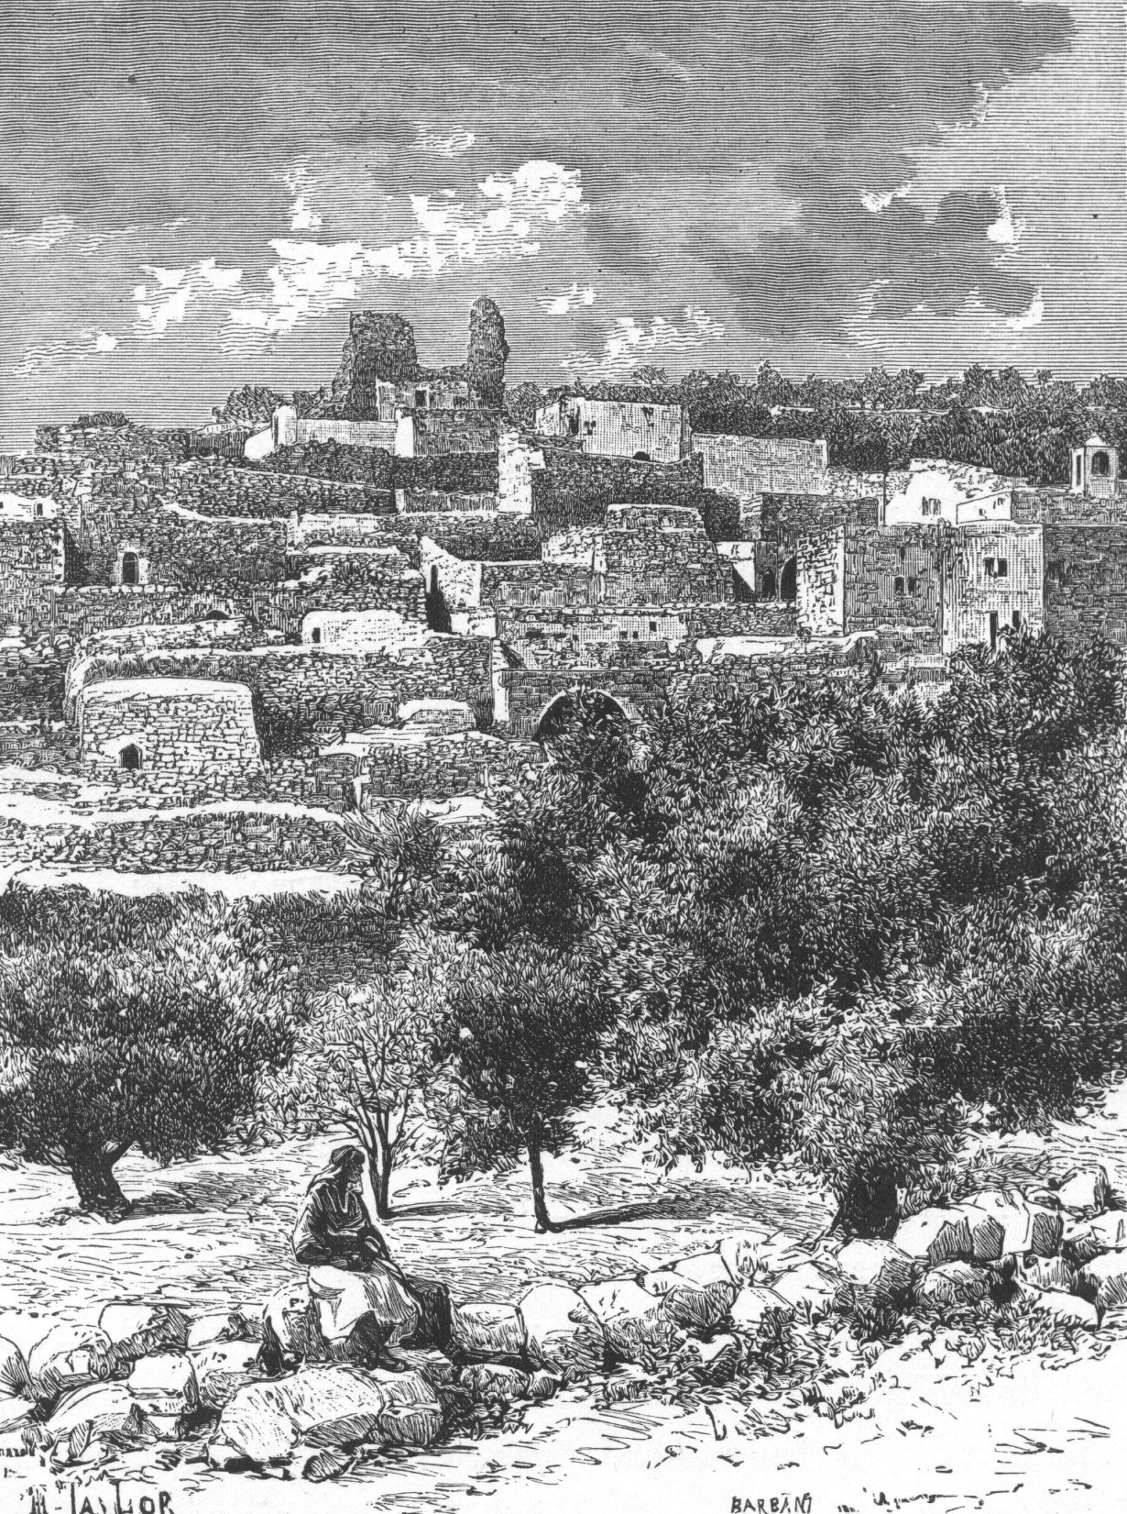
John 11.20-22: Martha therefore, when she heard that Jesus was coming, went to meet Him, but Mary stayed at the house. Martha then said to Jesus, “Lord, if You had been here, my brother would not have died. Even now I know that whatever You ask of God, God will give You.”
Bethany in 1880s / J.L. Porter
Jerusalem, Bethany, & Bethlehem
©2004 Todd Bolen

Slide 14
John 11.20-22: Martha therefore, when she heard that Jesus was coming, went to meet Him, but Mary stayed at the house. Martha then said to Jesus, “Lord, if You had been here, my brother would not have died. Even now I know that whatever You ask of God, God will give You.”

Slide 15
John 11.23-27: Jesus said to her, “Your brother will rise again.” Martha said to Him, “I know that he will rise again in the resurrection on the last day.” Jesus said to her, “I am the resurrection and the life; he who believes in Me will live even if he dies, and everyone who lives and believes in Me will never die. Do you believe this?” She said to Him, “Yes, Lord; I have believed that You are the Christ, the Son of God, even He who comes into the world.”

Slide 16
John 11.23-27: Jesus said to her, “Your brother will rise again.” Martha said to Him, “I know that he will rise again in the resurrection on the last day.” Jesus said to her, “I am the resurrection and the life; he who believes in Me will live even if he dies, and everyone who lives and believes in Me will never die. Do you believe this?” She said to Him, “Yes, Lord; I have believed that You are the Christ, the Son of God, even He who comes into the world.”
“…the one believing in me – even if he should [physically] die – will live” [or “come to life”]…
= Physical Resurrection at the end of time

Slide 17
John 11.23-27: Jesus said to her, “Your brother will rise again.” Martha said to Him, “I know that he will rise again in the resurrection on the last day.” Jesus said to her, “I am the resurrection and the life; he who believes in Me will live even if he dies, and everyone who lives and believes in Me will never die. Do you believe this?” She said to Him, “Yes, Lord; I have believed that You are the Christ, the Son of God, even He who comes into the world.”
“…everyone who is [spiritually] living and believing in me certainly will not die into eternity.”
= eternal life that begins now by grace through faith

Slide 18
John 11.23-27: Jesus said to her, “Your brother will rise again.” Martha said to Him, “I know that he will rise again in the resurrection on the last day.” Jesus said to her, “I am the resurrection and the life;
he who believes in Me will live even if he dies,
and everyone who lives and believes in Me will
never die. Do you believe this?” She said to Him, “Yes, Lord; I have believed that You are the Christ,
the Son of God, even He who comes into the world.”
Jesus is the only source for these blessings.

Slide 19
John 11.23-27: Jesus said to her, “Your brother will rise again.” Martha said to Him, “I know that he will rise again in the resurrection on the last day.” Jesus said to her, “I am the resurrection and the life; he who believes in Me will live even if he dies, and everyone who lives and believes in Me will never die. Do you believe this?” She said to Him, “Yes, Lord; I have believed that You are the Christ, the Son of God, even He who comes into the world.”
identity means capability
Greek perfect tense = past action, enduring results

Slide 20
John 11.28-31: When she had said this, she went away and called Mary her sister, saying secretly, “The Teacher is here and is calling for you.” And when she heard it, she got up quickly and was coming to Him. Now Jesus had not yet come into the village, but was still in the place where Martha met Him. Then the Jews who were with her in the house, and consoling her, when they saw that Mary got up quickly and went out, they followed her, supposing that she was going to the tomb to weep there.

Slide 21
John 11.32-34: Therefore, when Mary came where Jesus was, she saw Him, and fell at His feet, saying to Him, “Lord, if You had been here, my brother would not have died.” When Jesus therefore saw her weeping, and the Jews who came with her also weeping, He was deeply moved in spirit and was troubled, and said, “Where have you laid him?” They said to Him, “Lord, come and see.”

Slide 22
John 11.32-34: Therefore, when Mary came where Jesus was, she saw Him, and fell at His feet, saying to Him, “Lord, if You had been here, my brother would not have died.” When Jesus therefore saw her weeping, and the Jews who came with her also weeping, He was deeply moved in spirit and was troubled, and said, “Where have you laid him?” They said to Him, “Lord, come and see.”
ἐμβριμάομαι [em-bri-MAH-uh-my]
ταράσσω [tah-RAHS-so]

Slide 23
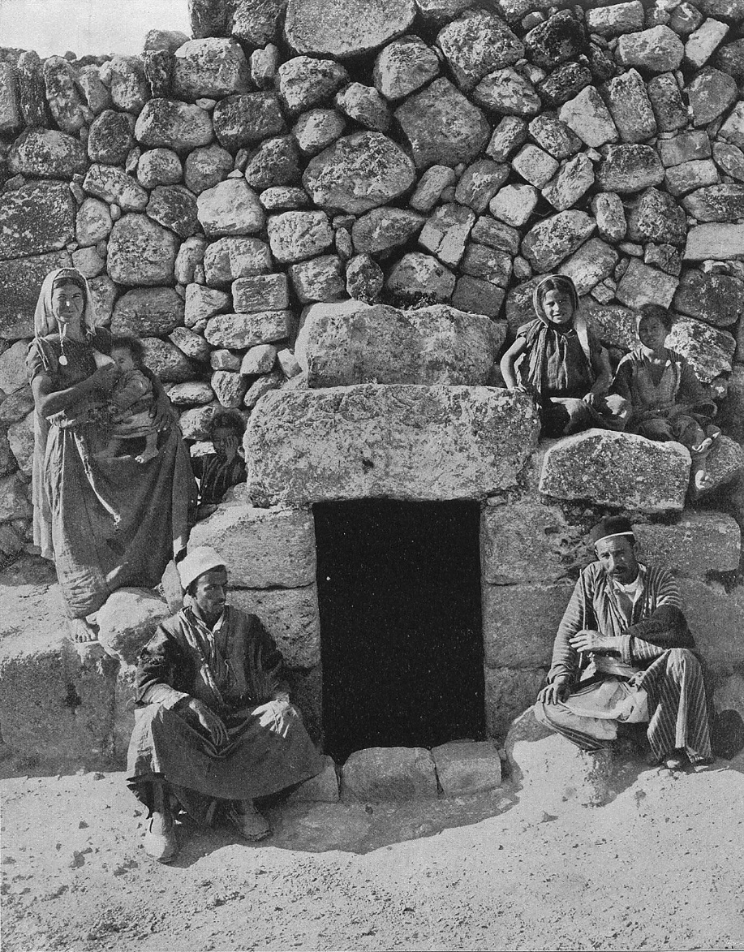
John 11.35-38: Jesus wept. So the Jews were saying, “See how He loved him!” But some of them said, “Could not this man, who opened the eyes of the blind man, have kept this man also from dying?” So Jesus, again being deeply moved within, came to the tomb. Now it was a cave, and a stone was lying against it.
Traditional tomb of Lazarus in 1890s Earthly Footsteps of the Man of Galilee / © 2003 Todd Bolen

Slide 24
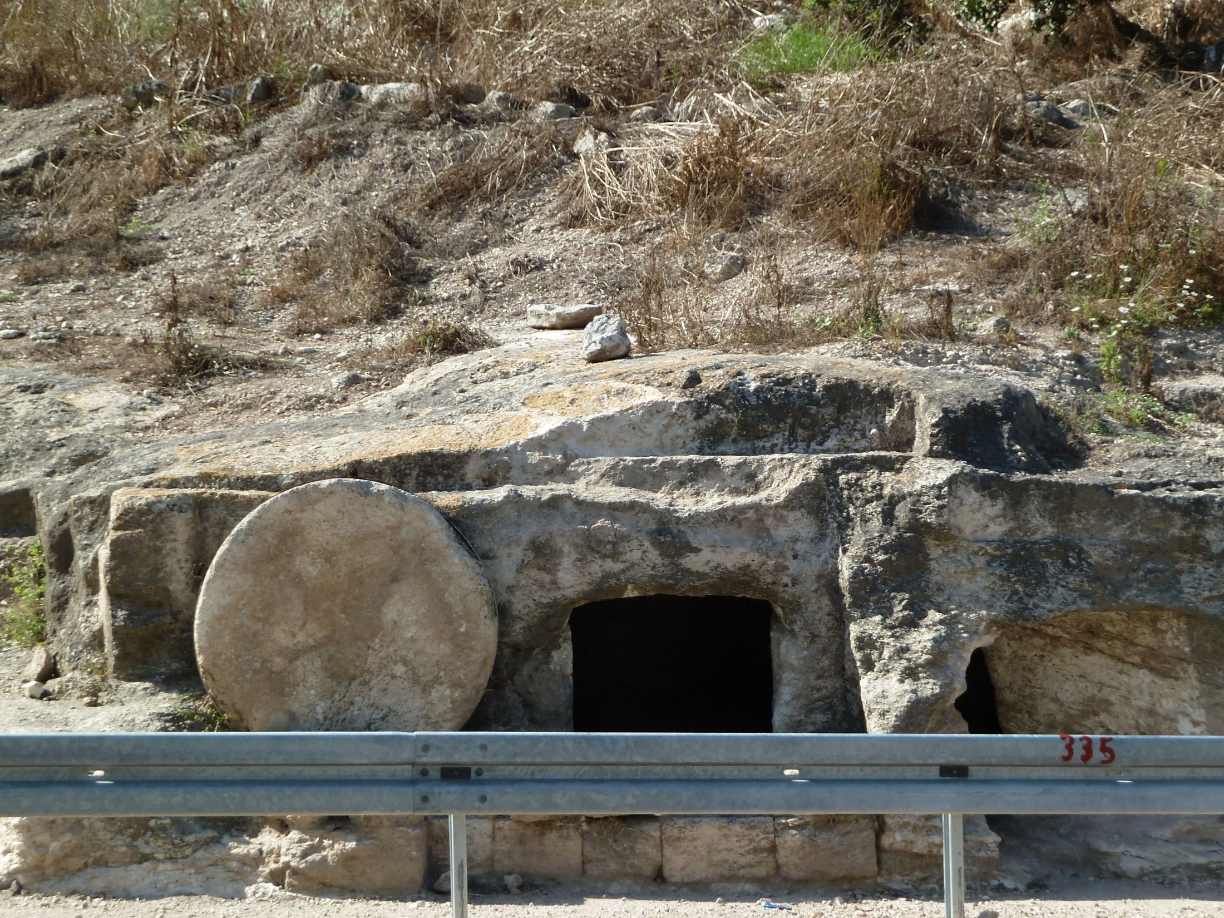
John 11.39-40: Jesus said, “Remove the stone.” Martha, the sister of the deceased, said to Him, “Lord, by this time there will be a stench, for he has been dead four days.” Jesus said to her, “Did I not say to you that if you believe, you will see the glory of God?”

Slide 25
John 11.41-46: So they removed the stone. Then Jesus raised His eyes, and said, “Father, I thank You that You have heard Me. I knew that You always hear Me; but because of the people standing around I said it, so that they may believe that You sent Me.” When He had said these things, He cried out with a loud voice, “Lazarus, come forth.” The man who had died came forth, bound hand and foot with wrappings, and his face was wrapped around with a cloth. Jesus said to them, “Unbind him, and let him go.” Therefore many of the Jews who came to Mary, and saw what He had done, believed in Him. But some of them went to the Pharisees and told them the things which Jesus had done.

Slide 26
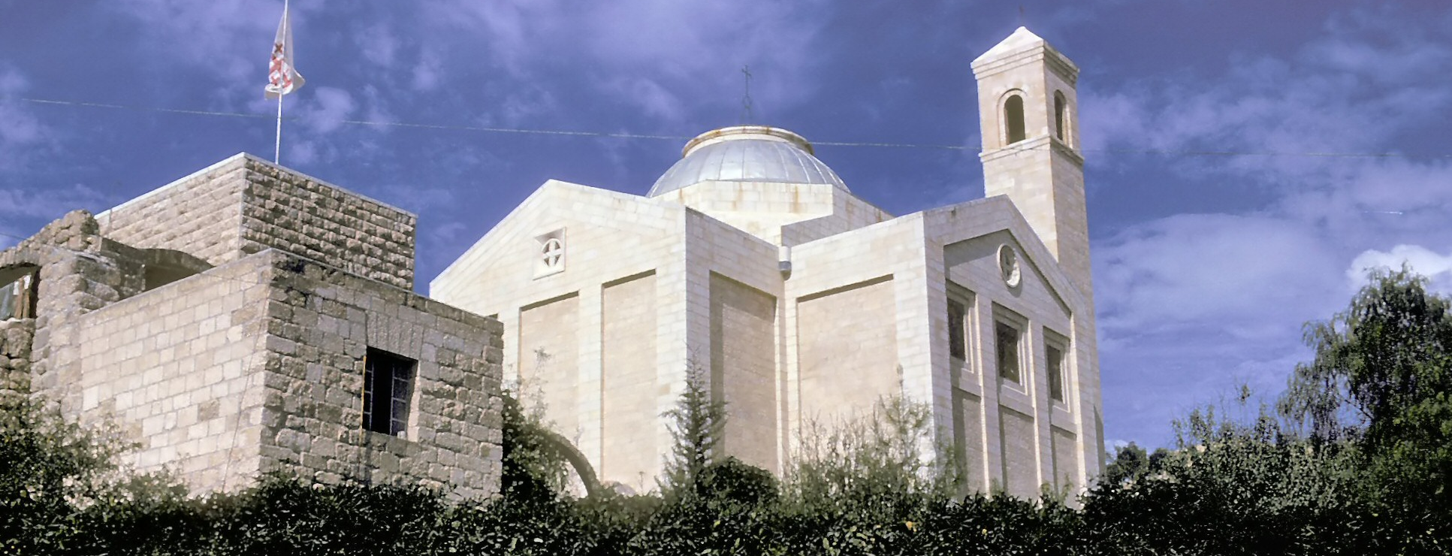
This miracle was a sign pointing backward…
Jesus identified himself as the “Son of Man” in the prophecies of Daniel, through whom God would raise the dead, end Gentile rule, and establish his kingdom on the Earth.
Church of Lazarus in Bethany in 1960s /
© 2003 Charles Lee Feinberg Family Trust

Slide 27
This miracle was a sign pointing backward…
Jesus identified himself as the “Son of Man” in the prophecies of Daniel, through whom God would raise the dead, end Gentile rule, and establish his kingdom on the Earth.
This miracle was a sign pointing forward…
Since Jesus could resurrect Lazarus, who had been dead long enough to be decomposing, we can believe that he can resurrect all the faithful on the last day.

